Slide 1

Data Analytics Part-time Bootcamp
Final project
Zsanett Borsos
May 19, 2022

Slide 2


Slide 3














Slide 4
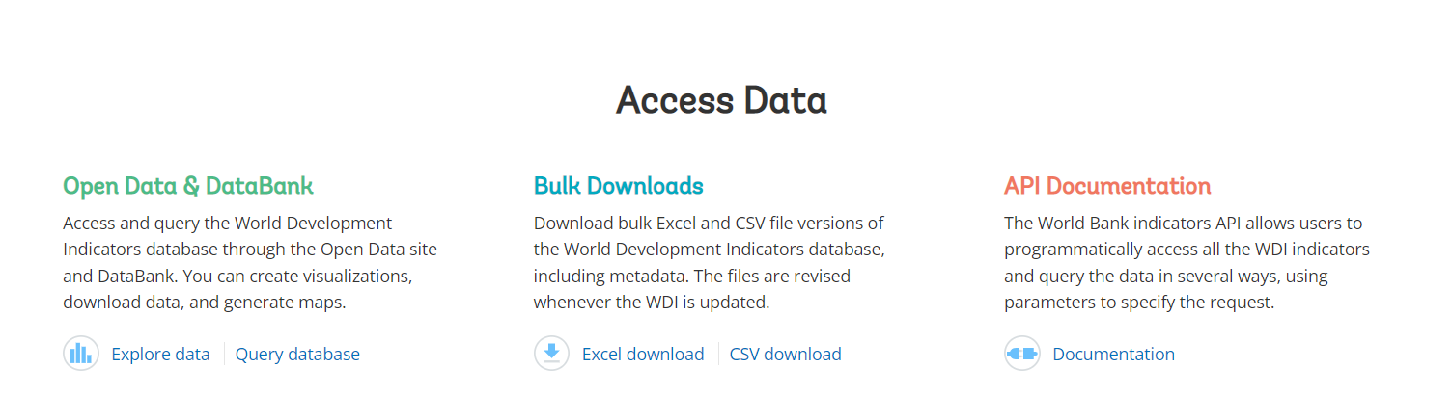

Slide 5




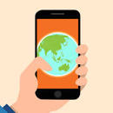
Individuals using the internet (% of the population)
Fixed telephone subscriptions (per 100 people)
Fixed broadband subscriptions (per 100 people)
Mobile cellular subscriptions (per 100 people)

Slide 6
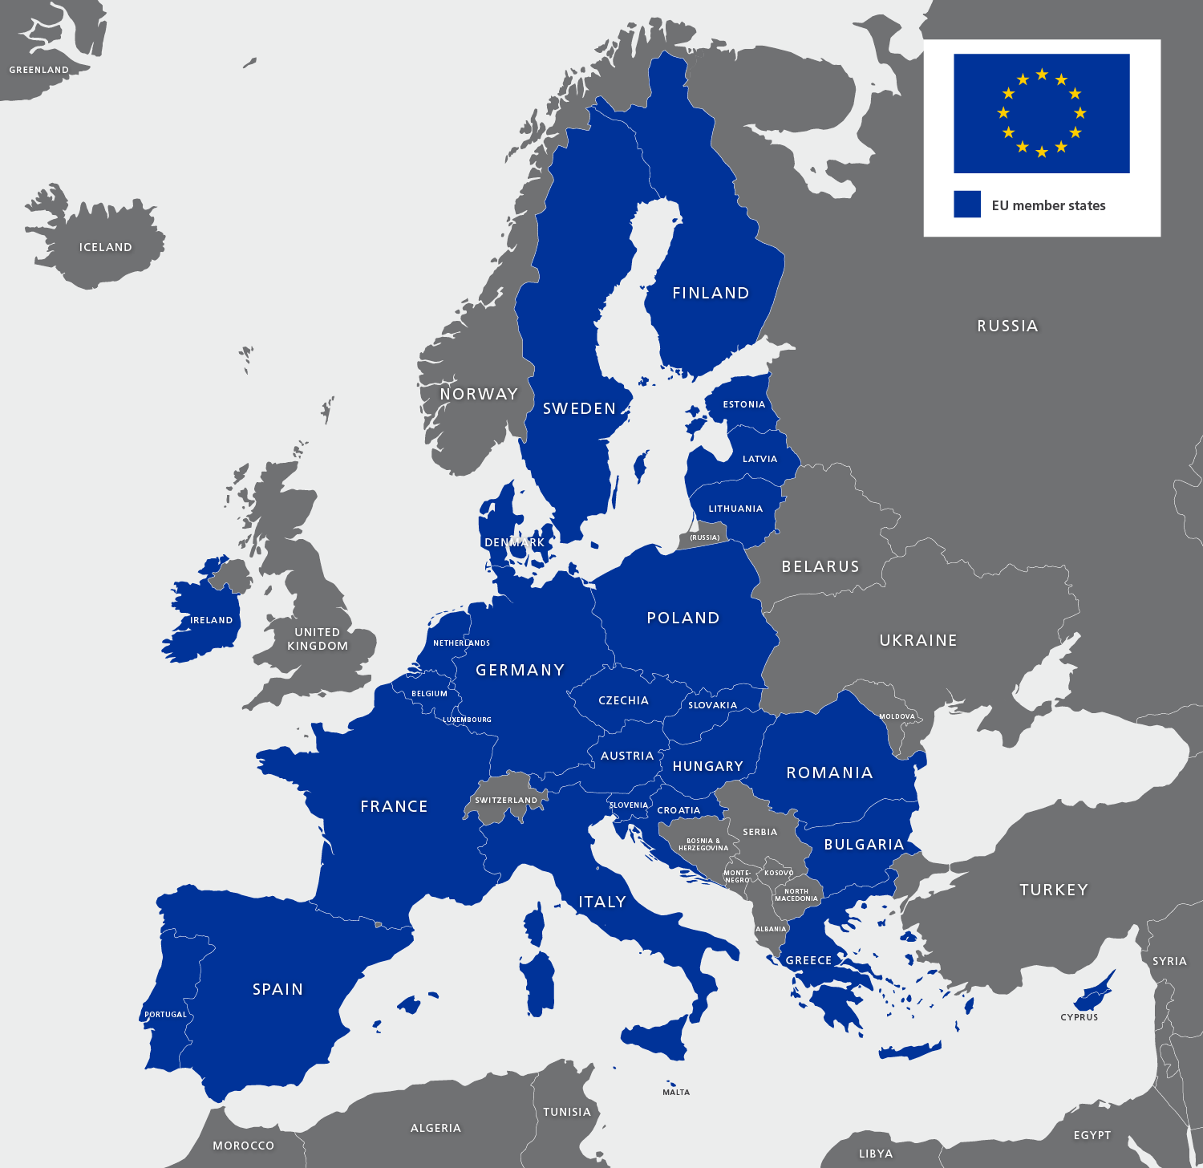

Slide 7
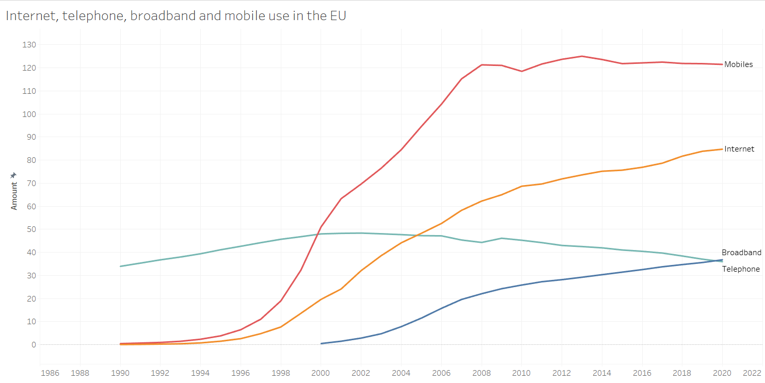

Slide 8
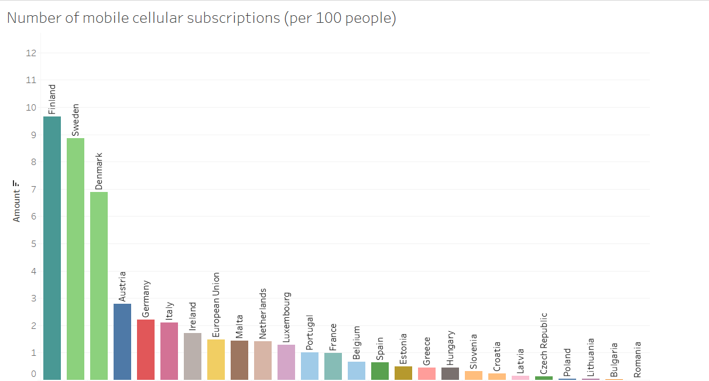
1993

Slide 9
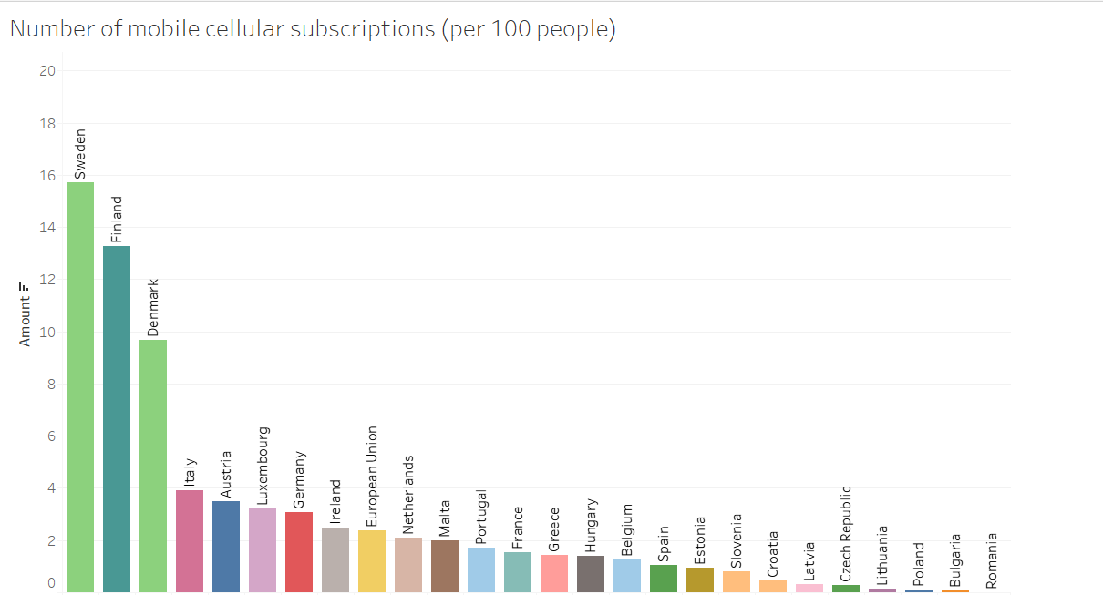
1994

Slide 10
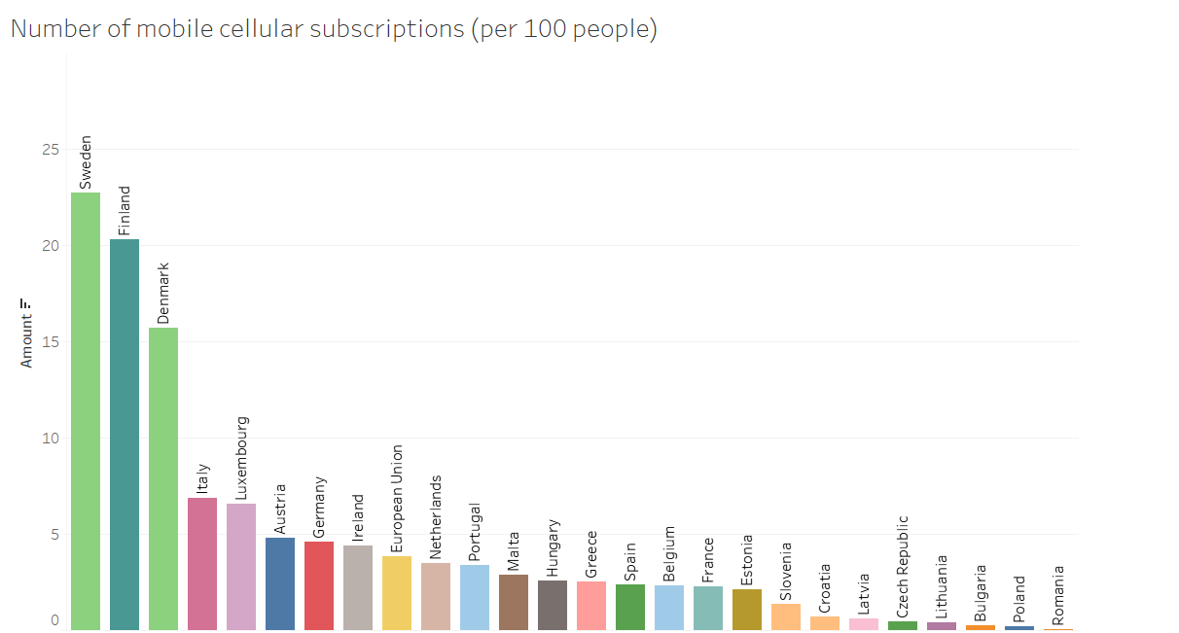
1995

Slide 11
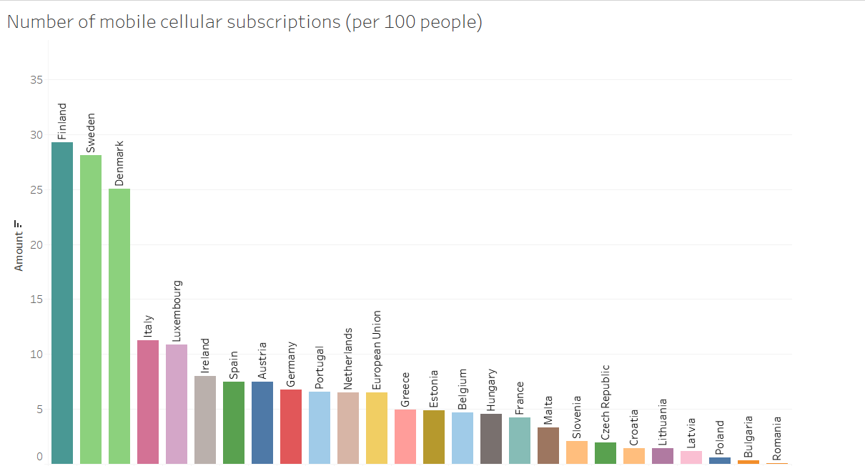
1996

Slide 12
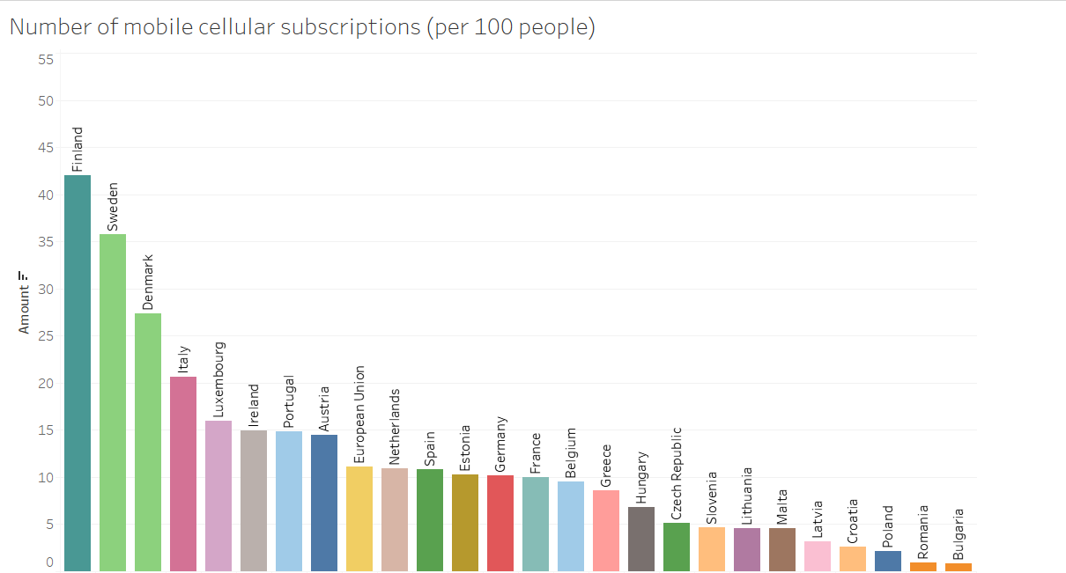
1997
The first commercial automated cellular networks (1G) in Europe was launched in in 1981 in Denmark, Finland, Norway, and Sweden.
The first 2G cellular networks were commercially launched in Finland in 1992.

Slide 13
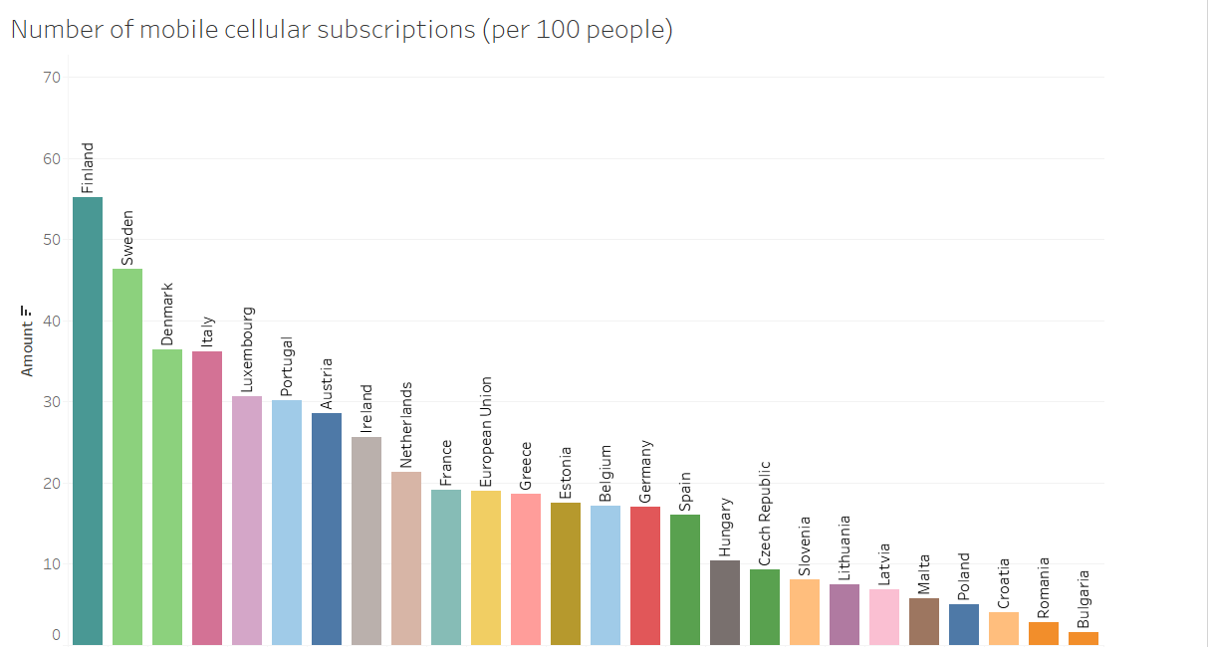
1998

Slide 14
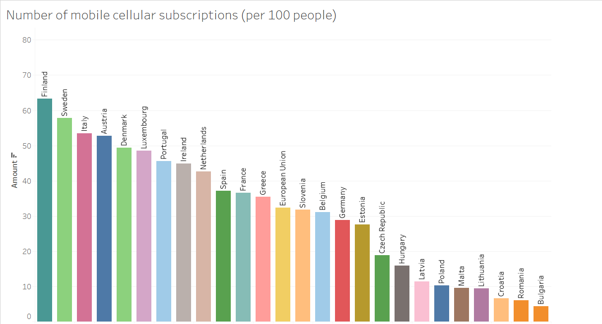
1999

Slide 15
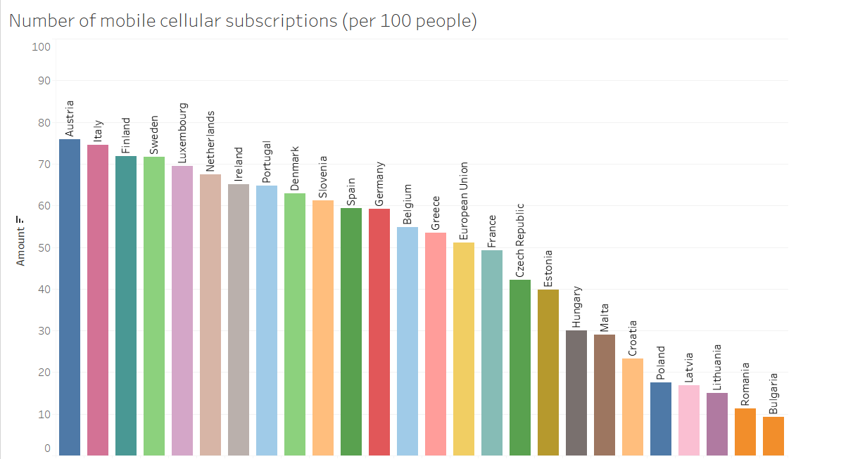
2000
The debut of the camera
Ericsson produces the first 'smartphone'.

Slide 16
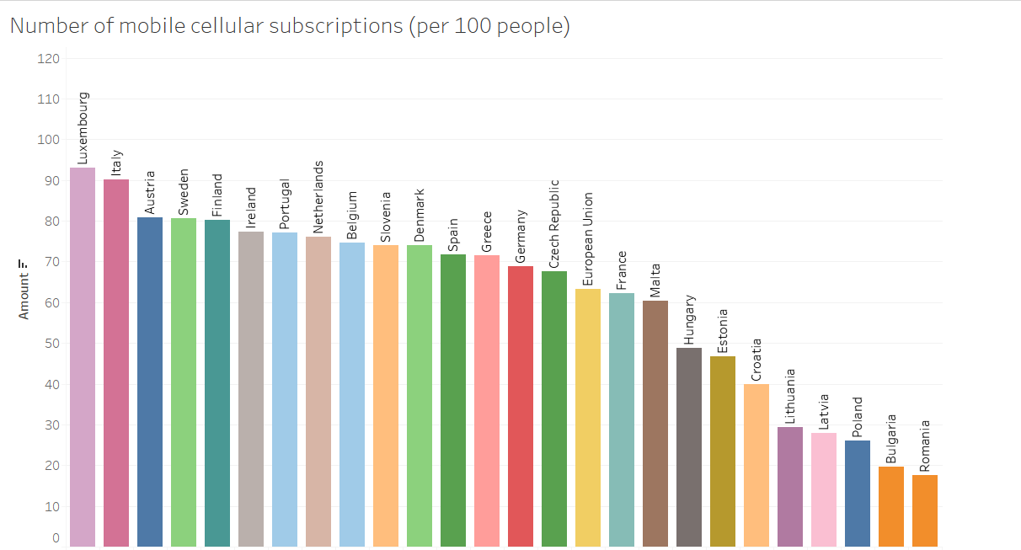
2001
3G!

Slide 17
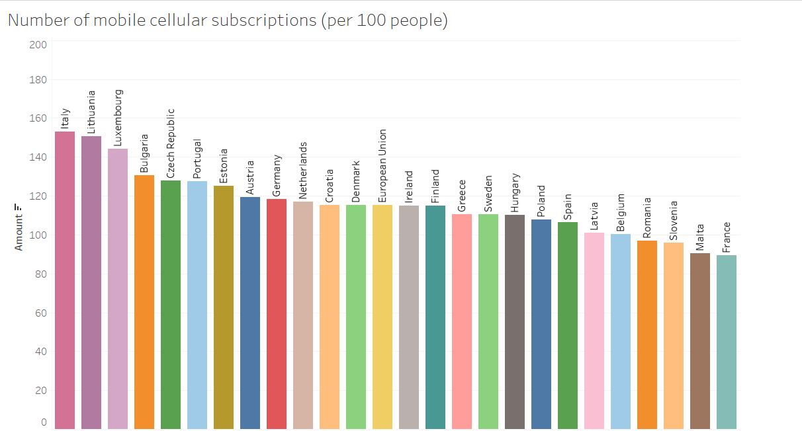
2007
The first Iphone hits stores.

Slide 18
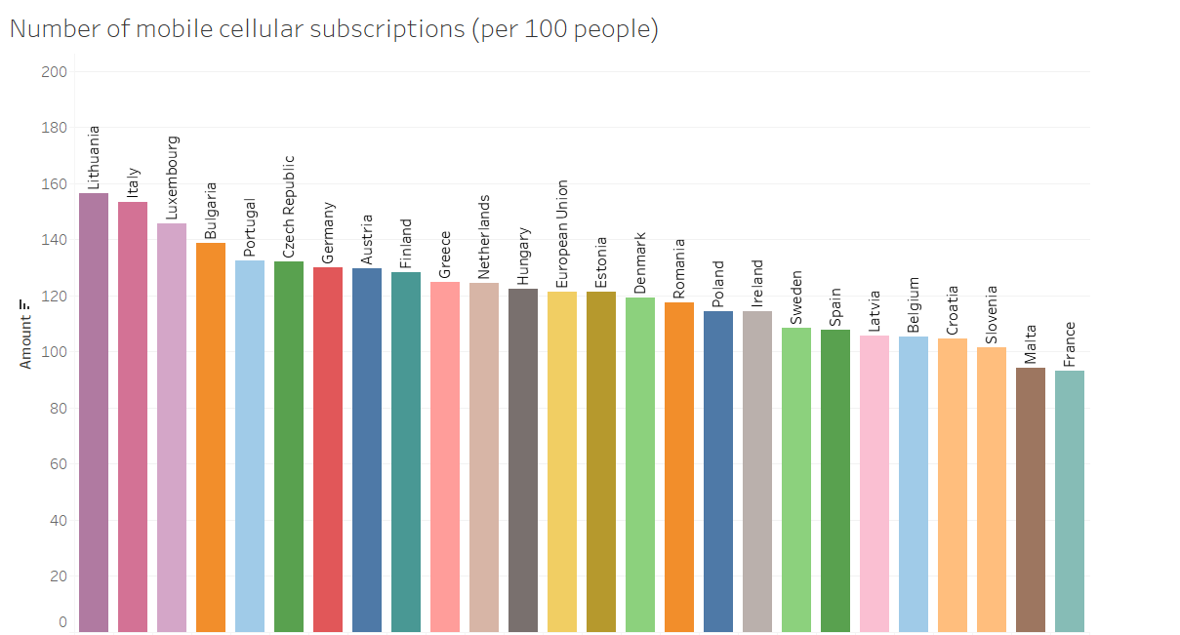
2008
Android arrives.

Slide 19
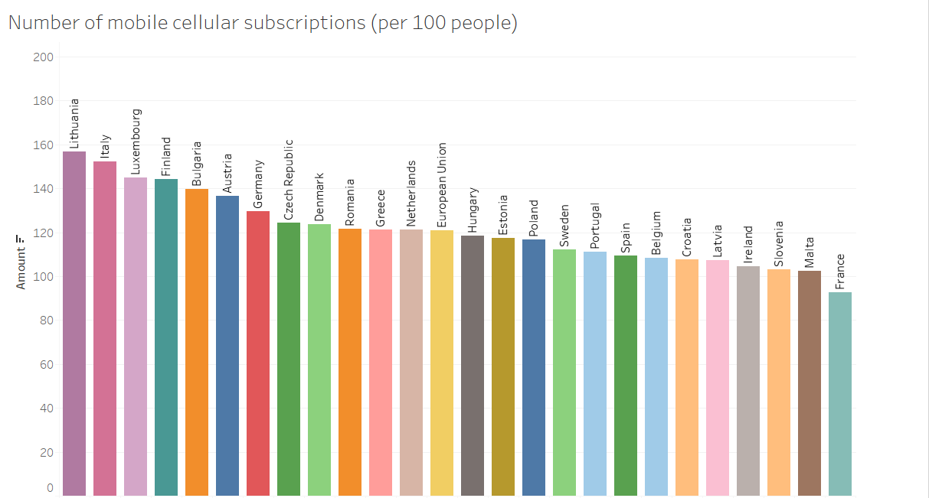
2009

Slide 20
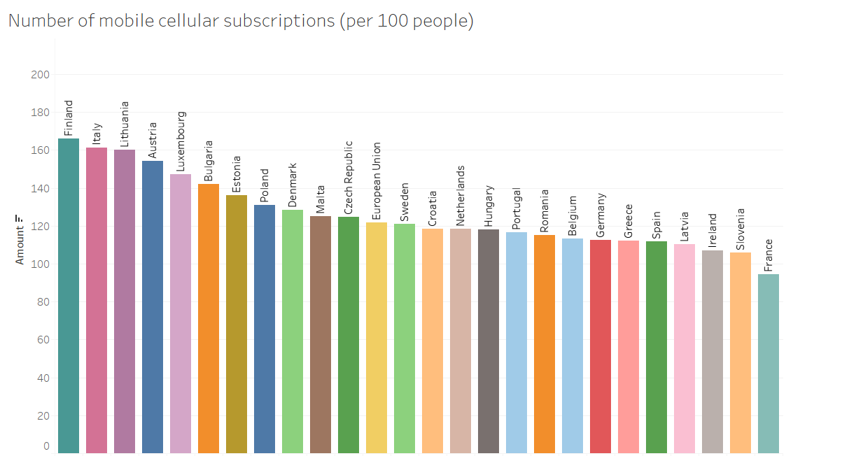
2011
4G!

Slide 21
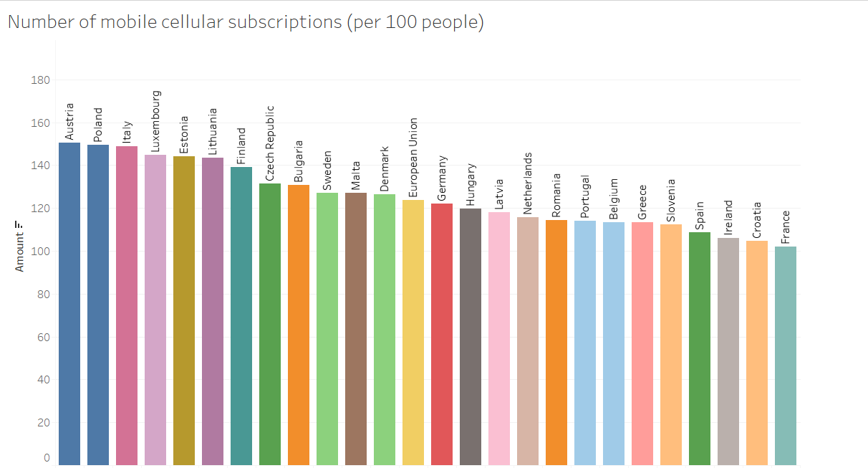
2014

Slide 23
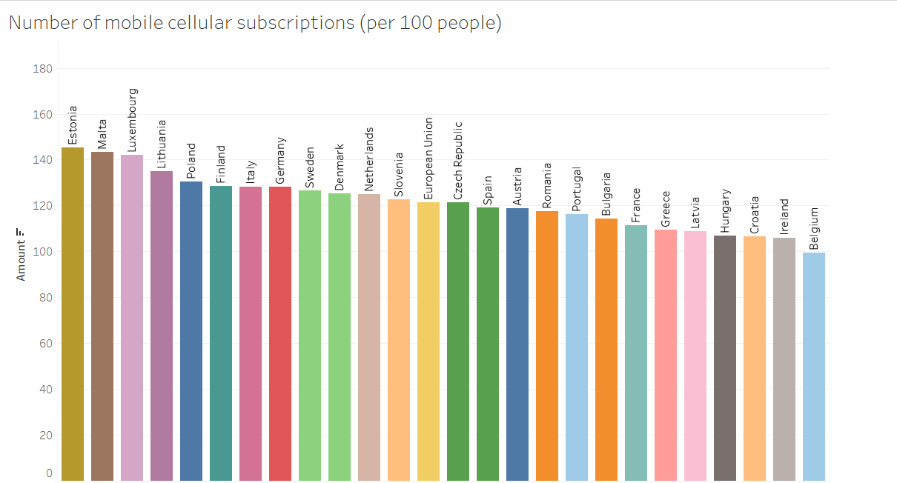
2020

